Slide 1
ML-Based Sodium Prediction for Hyponatremia
Diyali Goswami

Slide 2
Hyponatremia and Its Treatment Challenges
Hyponatremia:
A condition characterized by low serum sodium levels (<135 mEq/L) [1].
The most common disorder of body fluid and electrolyte balance in clinical practice.
Increased mortality, morbidity, and length of hospital stay.
Focus on patients with severe hyponatremia (serum sodium <120 mEq/L).
Treatment:
Accurate saline dosage is crucial for effective treatment.
Administration of desmopressin.
Greater than 50% of the patients suffer from under/over correction.
Undercorrection:
Can lead to persistent hyponatremia.
Overcorrection:
Can cause severe complications, including:
Osmotic demyelination syndrome (ODS).
Neurological damage.
[1] Spasovski, Goce et al. “Clinical practice guideline on diagnosis and treatment of hyponatraemia.” Nephrology, Dialysis, Transplantation: Official Publication of the European Dialysis and Transplant Association - European Renal Association, vol. 29 Suppl 2 (2014): i1-i39. doi:10.1093/ndt/gfu040.

Slide 3
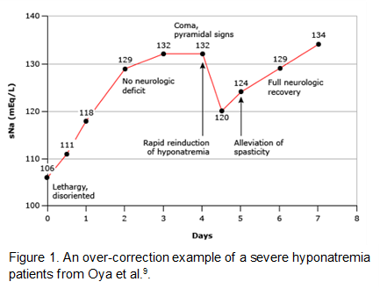
Difficulty in determining the appropriate saline dosage
An example of overcorrection in severe hyponatremia [2]
[2] Oya, S et al. “Reinduction of hyponatremia to treat central pontine myelinolysis.” Neurology vol. 57,10 (2001): 1931-2. doi:10.1212/wnl.57.10.1931

Slide 4
Study Objective
Utilize machine learning to predict serum sodium levels.
Realize the most important factors influencing serum sodium levels.
An example of overcorrection in severe hyponatremia [2]
[2] Oya, S et al. “Reinduction of hyponatremia to treat central pontine myelinolysis.” Neurology vol. 57,10 (2001): 1931-2. doi:10.1212/wnl.57.10.1931

Slide 5
About the dataset: MIMIC - IV
Overview:
The MIMIC-IV database is a large critical care database, containing health data from over 40,000 patients treated at the Beth Israel Deaconess Medical Center between 2001 and 2012. It includes a total of 299,712 patients and 431,231 admissions.
Hospital Module:
For this study, we focused on the hospital module, which contains data derived from the hospital-wide Electronic Health Record (EHR) system. This module includes both inpatient data and some outpatient data.
Inclusion Criteria:
Total Patients: 299,712
Hosp module patients:
225, 991
Patients with hyponatremia: 21,000
Patients with severe hyponatremia: 2,400
Patients with 50+ data points: 213

Slide 6

Clinician-Suggested Data for Hyponatremia Management
Current Serum Sodium:
Last serum sodium level used to decide the initiation of 3% saline treatment.
Desired Serum Sodium in 24-48 Hours:
Target increase of 6-8 mEq/L per day until serum sodium is above 130 mEq/L.
Urine Analysis:
Osmolarity: Helps assess the concentration of urine.
Sodium and Potassium Levels: Indicative of renal sodium handling and electrolyte balance.
Volume: Provides insights into fluid balance and renal function.
Demographic and Physical Data:
Age, gender, and weight of the patient.
Saline Administration:
Amount of 3% saline or total sodium added as recommended by the treatment model.
Patient Characteristics and Underlying Etiology:
Identifiable characteristics and conditions such as:
"Beer drinker’s potomania"
Hydrochlorothiazide use
Liver cirrhosis
Congestive Heart Failure (CHF)
Symptoms like poor oral intake, nausea, and vomiting
Current Total Daily Fluid Intake:
Amount of fluids consumed daily, critical for managing fluid restriction and therapy adjustment.

Slide 7
Data Filtering and Imputation
Data Filtering:
Filtered MIMIC-IV tables to include only patients with severe hyponatremia (serum sodium <120 mEq/L).
Removed predictors with more than 90% missing values such as urine volume, urine osmolality, urine sodium, urine potassium, etc.
Categorical Variable Encoding:
Encoded categorical variables into numerical representations.
Aggregation of Patient Data:
Aggregated relevant patient information, including height, weight, gender, age, and BMI.

Slide 8
Handling missing values in data preprocessing
Forward Fill (ffill) Method used for temporal variables to carry forward the last valid observation.
This is for temporal variables like Sodium, Potassium, Chloride, Creatinine, Urea Nitrogen, Bicarbonate, Anion Gap
Removed variables with more than 90% zero values.
Applied XGBoost regressor to predict missing lab event measurements and prescription dosages.
Training Data: Used rows without missing values.
Prediction Data: Used rows with missing values.
Model Training: Trained XGBoost regressor to predict missing values.

Slide 9
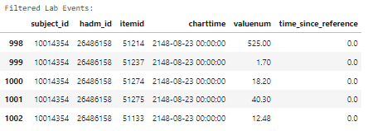
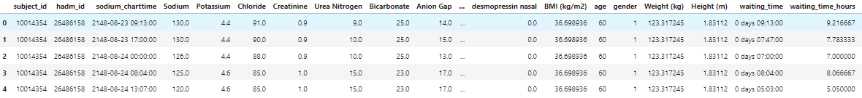
Data Homogenization for Time Series Analysis
Separate Data Streams: Information such as medication administrations and lab results are often recorded in separate tables and entries, even when they occur close together or simultaneously.
Merging Data: Tables were merged based on common identifiers such as subject_id, hadm_id, and charttime.
Homogenization Process: Each patient's records are aligned by the exact time of a significant medical event, such as sodium measurement in this case.

Slide 10
Data Preparation for Time Series Analysis
Preprocessed Features:
Utilized features from MIMIC-IV, focusing on patients with serum sodium <120 mEq/L .
Created lagged features for all temporal data points to capture previous timestep values.
Included time difference between a patients record as a feature as well.
Lagged Features Comparison:
Compared 1, 2, and 3 timesteps lagged features [3].
Group Shuffle Split:
Ensured distinct patient sets in training (80%) and testing (20%) datasets.
Implemented group shuffle split to maintain data integrity.
Timesteps lagged | Approx. hours
1 | 1.66
2 | 3.32
3 | 4.98
[3] Kinoshita, Tamaki & Oyama, Shintaro & Hagiwara, Daisuke & Azuma, Yoshinori & Arima, Hiroshi. (2023). A machine learning approach for predicting treatment response of hyponatremia. Endocrine Journal. 71. 10.1507/endocrj.EJ23-0561.

Slide 11
Predictors
Category | Predictor | Description
Basic Demographics | BMI (kg/m2) | Body mass index
 | Age | Age of the patient
 | Gender | Gender of the patient
 | Weight (kg) | Weight of the patient
 | Height (m) | Height of the patient
Waiting Time | waiting_time_hours | Hours since last recorded event
Electrolytes & Metabolites | Sodium_lag_1 to Sodium_lag_3 | Sodium levels at 1 to 3 time steps before
 | Potassium_lag_1 to Potassium_lag_3 | Potassium levels at 1 to 3 time steps before
 | Chloride_lag_1 to Chloride_lag_3 | Chloride levels at 1 to 3 time steps before
 | Bicarbonate_lag_1 to Bicarbonate_lag_3 | Bicarbonate levels at 1 to 3 time steps before
 | Anion Gap_lag_1 to Anion Gap_lag_3 | Anion gap at 1 to 3 time steps before
 | Glucose_lag_1 to Glucose_lag_3 | Glucose levels at 1 to 3 time steps before
 | Magnesium_lag_1 to Magnesium_lag_3 | Magnesium levels at 1 to 3 time steps before
Kidney Function | Creatinine_lag_1 to Creatinine_lag_3 | Creatinine levels at 1 to 3 time steps before
 | Urea Nitrogen_lag_1 to Urea Nitrogen_lag_3 | Urea Nitrogen levels at 1 to 3 time steps before

Slide 12
Predictors
Category | Predictor | Description
Blood Cells & Components | Hematocrit_lag_1 to Hematocrit_lag_3 | Hematocrit levels at 1 to 3 time steps before
 | Hemoglobin_lag_1 to Hemoglobin_lag_3 | Hemoglobin levels at 1 to 3 time steps before
 | Red Blood Cells_lag_1 to Red Blood Cells_lag_3 | RBC count at 1 to 3 time steps before
 | White Blood Cells_lag_1 to White Blood Cells_lag_3 | WBC count at 1 to 3 time steps before
 | Platelet Count_lag_1 to Platelet Count_lag_3 | Platelet count at 1 to 3 time steps before
Coagulation Factors | PT_lag_1 to PT_lag_3 | Prothrombin time (PT) at 1 to 3 time steps before
 | PTT_lag_1 to PTT_lag_3 | Partial thromboplastin time at 1 to 3 time steps before
 | INR(PT)_lag_1 to INR(PT)_lag_3 | International normalized ratio of PT at 1 to 3 time steps before
Liver Enzymes | Alanine Aminotransferase (ALT)_lag_1 to ALT_lag_3 | ALT levels at 1 to 3 time steps before
 | Asparate Aminotransferase (AST)_lag_1 to AST_lag_3 | AST levels at 1 to 3 time steps before
Medications & Treatments | insulin_lag_1 to insulin_lag_3 | Insulin administered at 1 to 3 time steps before
 | 0.9% sodium chloride_lag_1 to 0.9% sodium chloride_lag_3 | 0.9% Sodium Chloride administered at 1 to 3 time steps before
 | 5% dextrose_lag_1 to 5% dextrose_lag_3 | 5% Dextrose administered at 1 to 3 time steps before
 | sterile water_lag_1 to sterile water_lag_3 | Sterile water administered at 1 to 3 time steps before
 | furosemide_lag_1 to furosemide_lag_3 | Furosemide administered at 1 to 3 time steps before
 | desmopressin nasal_lag_1 to desmopressin nasal_lag_3 | Desmopressin nasal administered at 1 to 3 time steps before

Slide 13
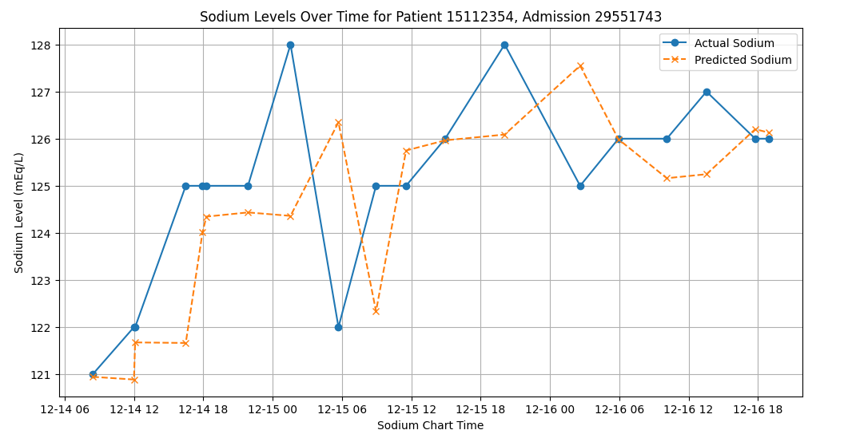
Model Development and Optimization
CatBoost is the best performing model.
Conducted GridSearch to fine-tune CatBoost parameters: learning rate, tree depth, L2 regularization, and number of iterations.
Verified the performance on the test set with optimized parameters.

Slide 14
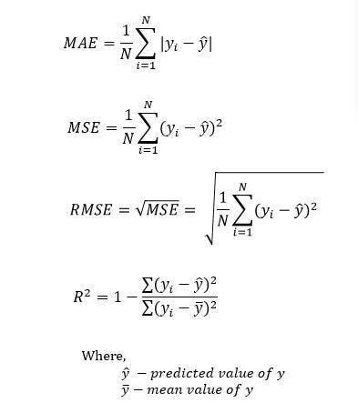
Evaluating Model Performance: Error Metrics
Mean Absolute Error (MAE):It’s the mean of the absolute values of each prediction error on individual data points.
Mean Squared Error (MSE):Measures the average squared difference between the estimated values and the actual value.
R-squared (R²):Provides an indication of goodness of fit and therefore a measure of how well unseen samples are likely to be predicted by the model, through the proportion of explained variance.

Slide 15
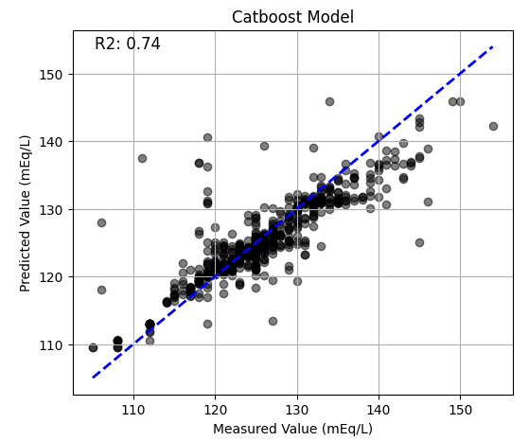
Catboost Model Performance
R2: 0.74 , MSE: 13.96 and MAE: 2.23

Slide 16
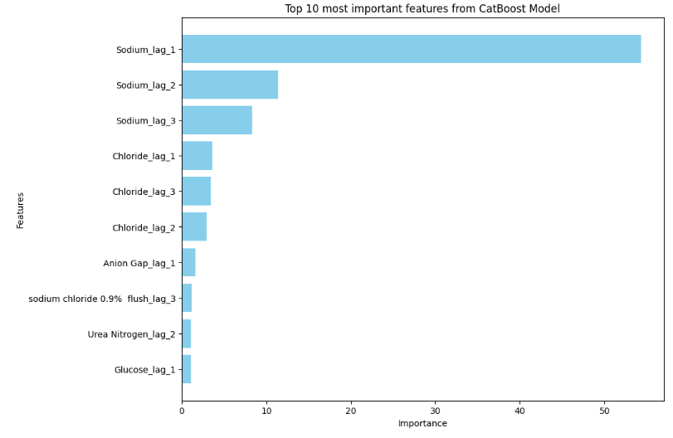
Key Feature Importances from CatBoost Model
Top Features:
Sodium Levels: Sodium lag 1, 2, and 3 are the most important features, significantly impacting the model's predictions.
Chloride Levels: Chloride lag 1, 2, and 3 also play a crucial role in predicting serum sodium levels.
Anion Gap: Anion Gap lag 1 and lag 3 are significant contributors to the model.
Urea Nitrogen: Both lag 2 and 3 of Urea Nitrogen are important predictors.
Saline Administration:
Sodium chloride 0.9% flush lag 1 and lag 3 are notable features, indicating the importance of saline administration in the model.

Slide 17
Prediction Delay in Sodium Levels
Sodium_lag_1 alone: R2 score of 0.69.
Excluding Sodium_lag_1: R2 score drops to 0.67.
Removing Sodium_lag_1, Sodium_lag_2, and Sodium_lag_3: R2 score drops to 0.60.
Including all features: R2 score increases to 0.74.
High importance of Sodium_lag_1 indicates strong reliance on past sodium levels.
Including multiple lagged features smoothens predictions, causing slight delays.
Lagged features provide context but introduce time-lag as they balance past and current values.

Slide 18
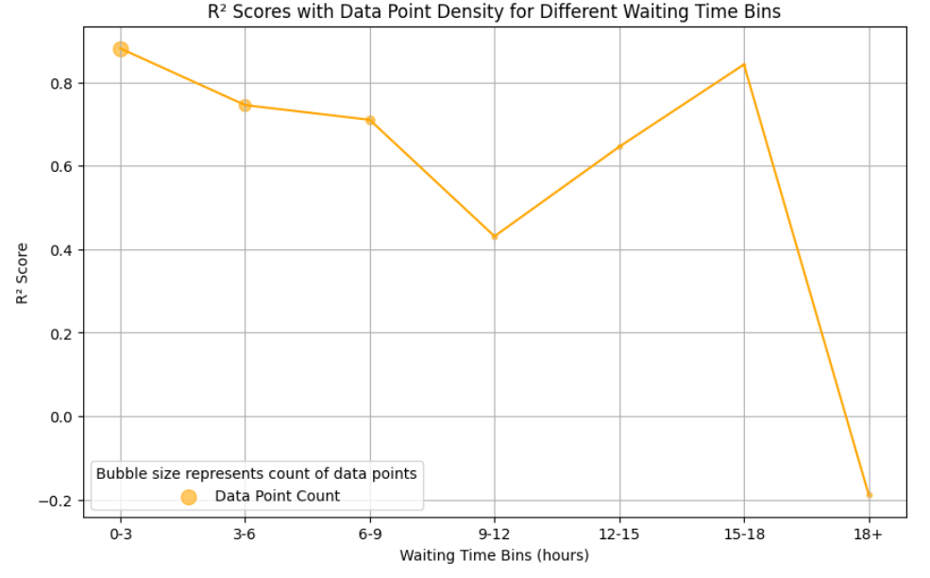
Model works the best within 10 hours

Slide 19
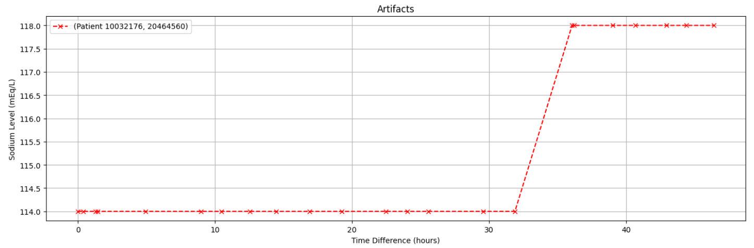
Investigating Potential Data Artifacts in Sodium Level Measurements

Slide 20
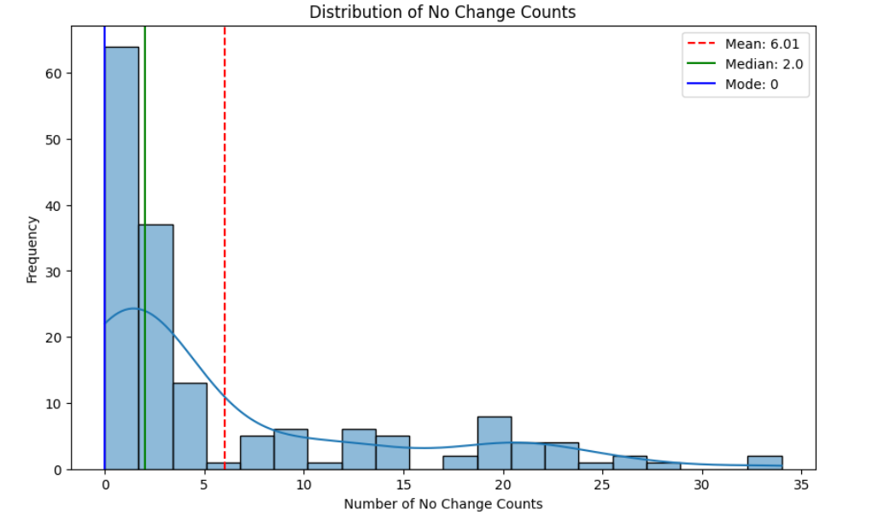
Distribution of No Change Counts in Serum Sodium
Investigated the "no change count" for each patient, which indicates the number of consecutive instances with no change in sodium levels.
Many patients exhibit no change in serum sodium levels over extended consecutive time points.
This raises concerns about data integrity, possibly indicating archival data entries.
Noticed a bimodal distribution pattern in the distribution.
The bimodal distribution suggests two distinct groups of patients: those with frequent updates and those with extended periods of no change.

Slide 21
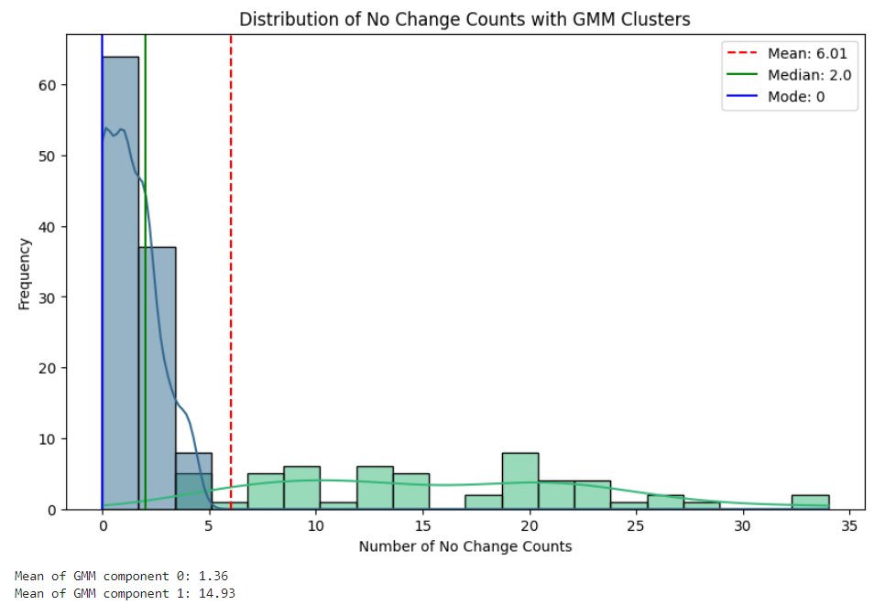
Distribution of No Change Counts in Serum Sodium Levels with GMM Clusters
Applied Gaussian Mixture Model (GMM) to identify underlying clusters in the data.
Component 0: Predominantly represents lower counts of no change instances, indicating frequent changes in sodium levels.
Component 1: Represents higher counts of no change instances, suggesting prolonged periods of no change in sodium levels.

Slide 22
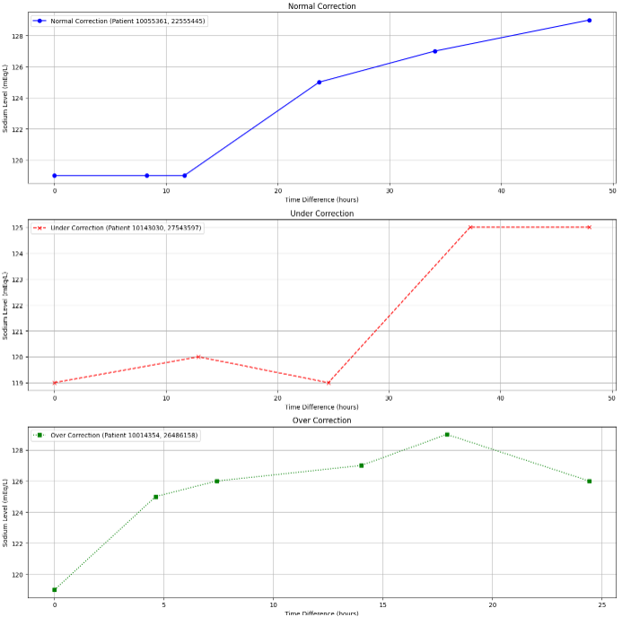

Sodium Correction Rates
Sodium Correction Rate: The rate at which sodium levels are adjusted is calculated by dividing the change in sodium levels by the elapsed time in hours.
Formula: Sodium rate= $\frac{\text{ΔSodium}}{\text{Δtime}\text{(}\text{hours}\text{)}}$
To understand the rate of sodium change on a daily basis, which is standard in clinical practice, the calculated rate is then adjusted by dividing by 24.
Correction Criteria:
Under Correction: If the rate of increase in sodium is less than 4 mEq/L over 24 hours.
Normal Correction: A rate between 4 and 12 mEq/L per 24 hours signifies a normal correction.
Over Correction: Exceeding a 12 mEq/L increase per 24 hours is classified as over correction.

Slide 23
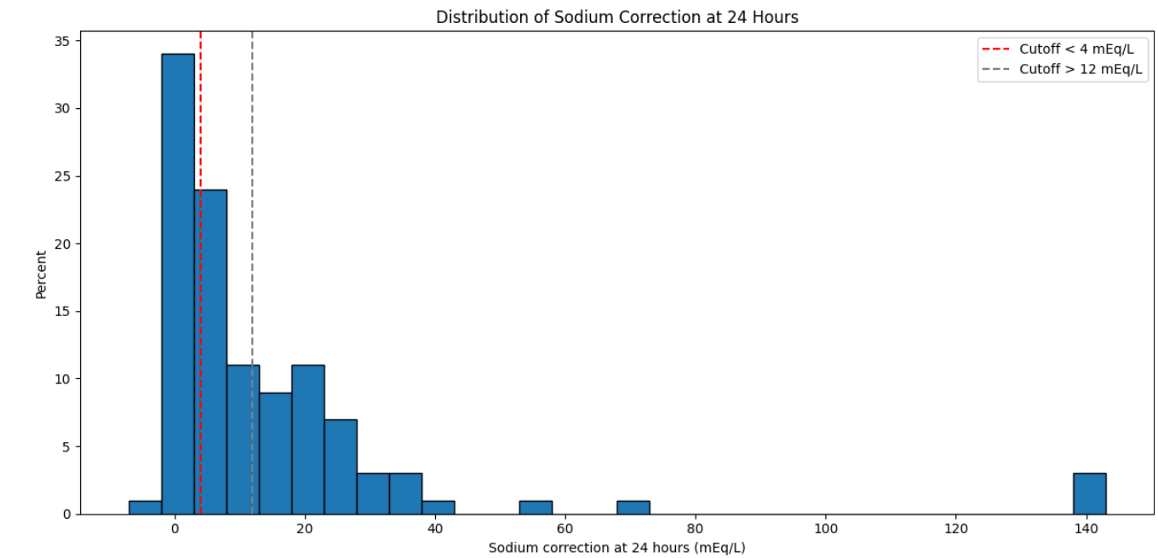
Distribution of Sodium Correction at 24 Hours
Undercorrection (<4 mEq/L):
Approximately 60% of patients fall below the normal correction range.
Normal Correction (4-12 mEq/L):
About 25% of patients achieve the desired correction range.
Overcorrection (>12 mEq/L):
A minimal percentage of patients exceed the normal correction range.

Slide 24
Analysis of Sodium Correction Rates in Patients (4 to 12 mEq/L)
Sodium Correction Classification:
Under-correction: 458 instances (< 4 mEq/L)
Over-correction: 137 instances (> 12 mEq/L)
Normal correction: 116 instances (4 to 12 mEq/L)
Average Total Sodium Chloride Administration:
Normal correction:
0.9% sodium chloride: 1653.34 mL
Sodium chloride 0.9% flush: 39.95 mL
Over-correction:
0.9% sodium chloride: 1473.94 mL
Sodium chloride 0.9% flush: 39.62 mL
Under-correction:
0.9% sodium chloride: 1356.90 mL
Sodium chloride 0.9% flush: 37.62 mL
Here the correction rates are only looked at from the first instance of serum sodium dropping below 120 mEq/L. Only component 0 patients are analyzed.
Inference:
Correction Types:
Under-correction: Most common, indicating potential under-treatment.
Over-correction: Less frequent.
Normal correction: Least common.
Sodium Chloride Administration:
Over-correction patients received the moderate volumes.
Normal correction patients received highest volumes.
Under-correction patients received the least, indicating a potential need for more fluids.

Slide 25
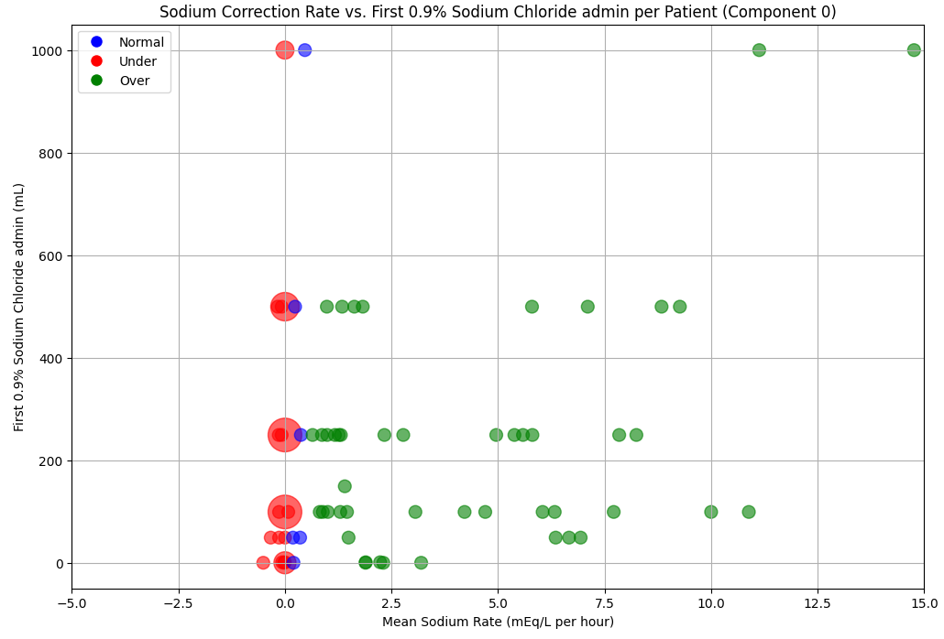
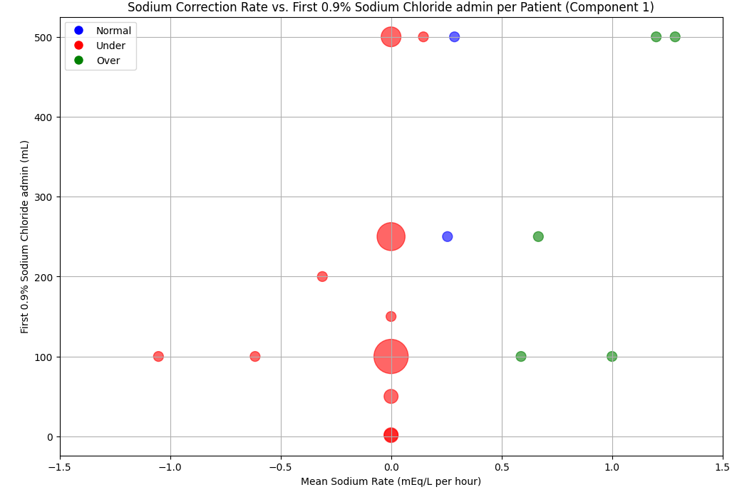
Consistent undercorrection hints at possible data integrity issues in Component 1

Slide 26
Component-wise Analysis of Sodium Correction Rate vs. First 0.9% Sodium Chloride
Component 0 Insights:
Clustering of Data Points:
Most data points cluster around a mean sodium rate close to zero.
There is a wide range of sodium chloride administered, with some patients receiving up to 1000 mL.
Correction Types:
Most corrections are categorized as 'Over' correction, indicating a high increase in sodium rate.
Indicates more active and varied sodium correction interventions with a significant number of 'Over' corrections.
This suggests that patients in this component have experienced more aggressive sodium correction treatments.
Component 1 Insights:
Clustering of Data Points:
Sodium rates tightly cluster around zero, with fewer outliers compared to Component 0.
The first 0.9% sodium chloride administered is generally lower, with most patients receiving less than 500 mL.
Correction Types:
Corrections are predominantly classified as 'Under' correction.
This indicates minimal or no change in sodium rate, suggesting that the patients in this component might have archival records.
The consistent undercorrection hints at possible data integrity issues or conservative treatment approaches for these patients

Slide 27
Component-wise Performance of CatBoost Model
Component 0 Performance: Achieved an R2 score of 0.81.
Component 1 Performance: Achieved an R2 score of 0.66.
The higher R2 score suggests that the CatBoost model is more effective in predicting serum sodium levels for Component 0 patients.
This component likely includes patients with more consistent and updated sodium level records.
The lower R2 score for Component 1 indicates that the model has reduced accuracy for this group.
The moderate performance may be attributed to potential archival records or less frequent updates in sodium levels for these patients.

Slide 28

Caveats of the Dataset
Missing Important Features: Key features related to patient's urine output and medication details are not available in the dataset, limiting comprehensive analysis.
Incomplete Diagnosis Information: The dictionary for diagnoses is not comprehensive enough, with many important diagnosis codes missing values.
Non-Uniform Data Recording: The dataset has non-uniform recording intervals, leading to inconsistencies in the temporal resolution of patient data.
Variable Data Density: There is a significant disparity in the number of data points per patient; some patients have extensive longitudinal data, while others have minimal records.
Limited Information on 3% NaCl Administration: The dataset lacks sufficient details about the administration of 3% NaCl solution, a critical component for analyzing sodium correction in hyponatremia treatment.

Slide 29

Conclusion
Model Performance Metrics:
Mean Absolute Error (MAE): 2.23
Mean Squared Error (MSE): 13.96
R² Score for Whole Dataset: 0.74
Component-wise R² Scores:
Component 0: 0.81
Component 1: 0.66
Identifying Important Features:
Previous sodium levels and other lagged lab measurements were identified as critical predictors for sodium correction.
Optimal Lagged Number of Features:
The model performed best when considering features lagged by three timesteps.
Best Time Window for Sodium Level Recording:
A 48-hour window was found to be optimal for recording sodium levels to balance timely treatment adjustments with data accuracy.
Impact of Data Recording Intervals:
The R² score significantly falls when the interval between two records exceeds 10 hours, highlighting the need for more frequent data recording.

Slide 30
Potential Future Work
Deep Learning Models: Explore the use of advanced deep learning models such as Recurrent Neural Networks (RNNs) and Long Short-Term Memory (LSTM) networks to capture complex temporal dependencies in patient data for better prediction accuracy.
Transformers for Better Prediction: Implement Transformer models to enhance the prediction of sodium levels by leveraging their ability to handle long-range dependencies and large-scale data efficiently.
Requesting Additional Data: Seek to obtain more comprehensive datasets that include crucial missing features such as detailed urine output and specific medication records to improve model performance and accuracy.
Data Extraction from Additional Sources: Collaborate with institutions like Maine Medical Center and Veteran Affairs to extract and integrate their patient data, enriching the dataset and providing a more diverse and robust basis for model training.
Causal Machine Learning: Utilize causal machine learning techniques to better understand the causal relationships between treatment actions and patient outcomes, thereby providing more precise and actionable recommendations for clinicians.

Slide 31
Thank you!

